Slide 1

CSS
Lesson 5

Slide 2

CSS Lists
The CSS list properties allow you to:
Set different list item markers for ordered lists
Set different list item markers for unordered lists
Set an image as the list item marker

Slide 3



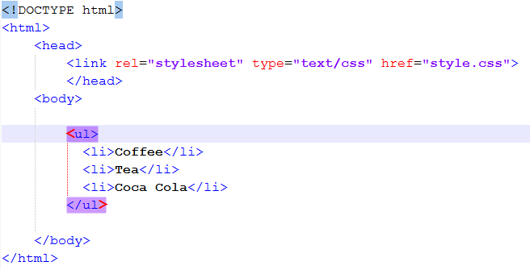
CSS Lists
List – style- type
style.css
doc.html

Slide 4

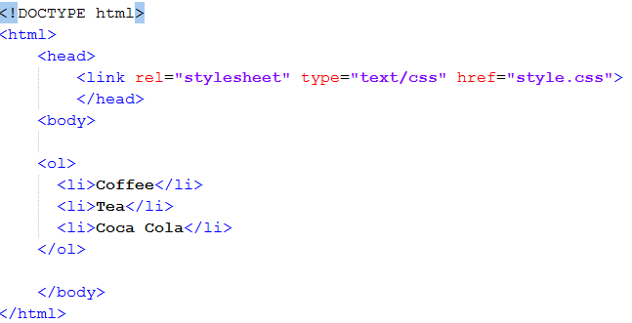
CSS Lists
style.css
List – style- type
doc.html

Slide 5
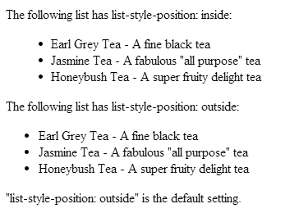

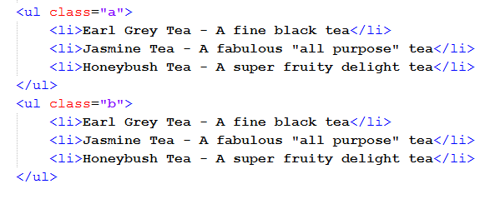
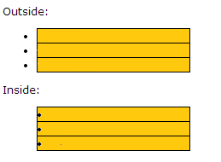
CSS Lists
List – style- position
style.css
doc.html
item1
item2
item3
item1
item2
item3

Slide 6
CSS Lists
List – style - image
An Image as The List Item Marker
style.css
doc.html

Slide 7
CSS Lists
List - Shorthand property
list-style-type
list-style-position
list-style-image

Slide 8

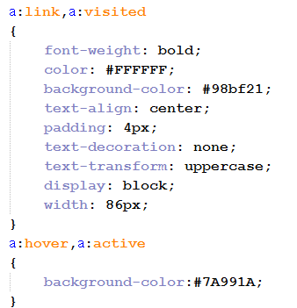
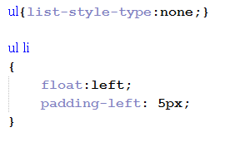
CSS Lists
Navigation Bar

Slide 9
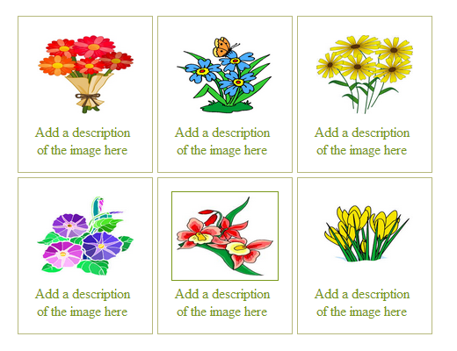
Task1:

Slide 10
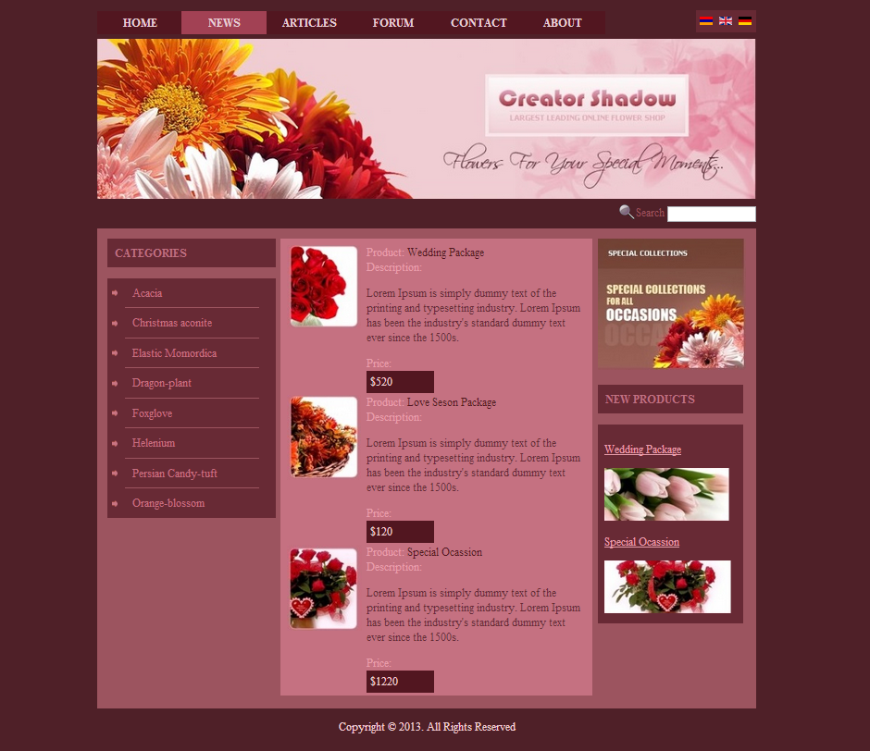
Task2:

